Slide 1
BCATML Annual General Meeting
Friday, October 22, 2021
Held virtually on easyREG

Slide 2
Establishment of quorum:
A quorum at the Annual General Meeting shall consist of at least five percent of the active members of the Association. This year that amounts to 25 BCTF members.
As per the BCATML Constitution, only active BCTF members of the BCATML in good standing are eligible to vote.
Notes:
As per BCATML Constitution, only active BCTF members in good standing are eligible to vote.

Slide 3
BCATML Annual General Meeting Agenda:
Call to order at 8:30 am
Acknowledgement of the unceded and traditional lands of the Musqueam First Nation.
Adoption of the BCATML AGM Minutes of Friday, October 23, 2020.
Recognition of BCATML Executive and Conference Committee members.
BCATML Constitutional amendment
President’s report; adoption of BCATML Program statement.
Treasurer’s report; adoption of BCATML Operating Budget 2021-22.
Election of BCATML Executive Committee 2021-22.
Adjournment
Motion #1: To adopt the agenda as presented.

Slide 4
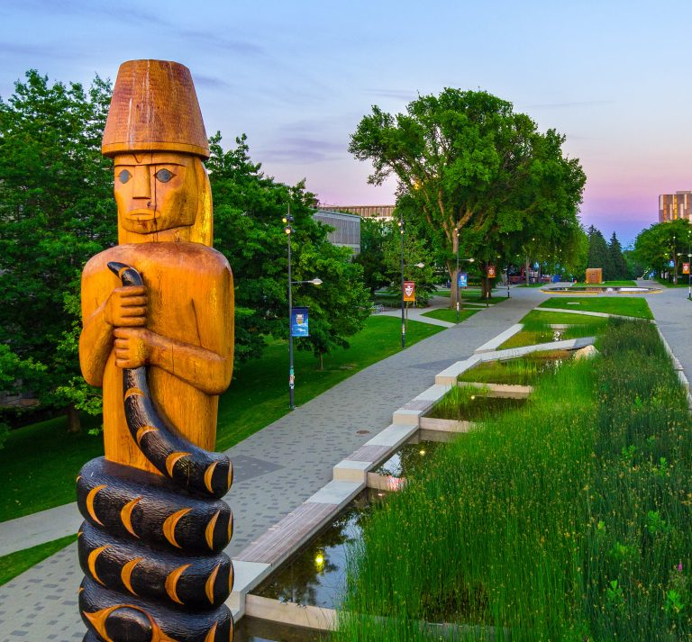
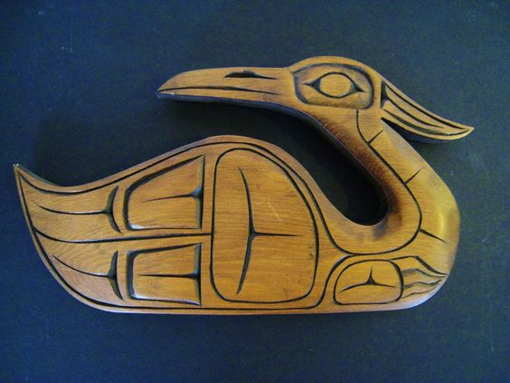
xʷməθkʷəy̓əm
xʷməθkʷəy̓əm (Musqueam) people have lived in their traditional territory, what is currently called Vancouver and the surrounding areas, for thousands of years. Some of their sχʷəy̓em̓ (ancient histories) describe the landscape as it was over eight thousand years ago.
BCATML would like to begin by acknowledging that our Celebrating Languages Conference is being hosted on unceded Indigenous lands. The xʷməθkʷəy̓əm (Musqueam) Nation is recognized as the custodians of the lands and waters on which we gather today and we thank them for this opportunity.
Notes:
This year’s conference is being hosted on the traditional and unceded territories of the Musqueam nation who are the stewards and custodians of the lands and waters on which we gather today.

Slide 5
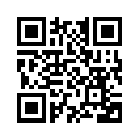
3. Adoption of 2020 AGM minutes:
Motion #2: To adopt the 2020 BCATML Annual General Meeting minutes of Friday, October 23, 2020.
QR Code to BCATML 2020
AGM Minutes
Notes:
Motion #2: To adopt the 2020 BCATML Annual General Meeting minutes of Friday, October 23, 2020.

Slide 6
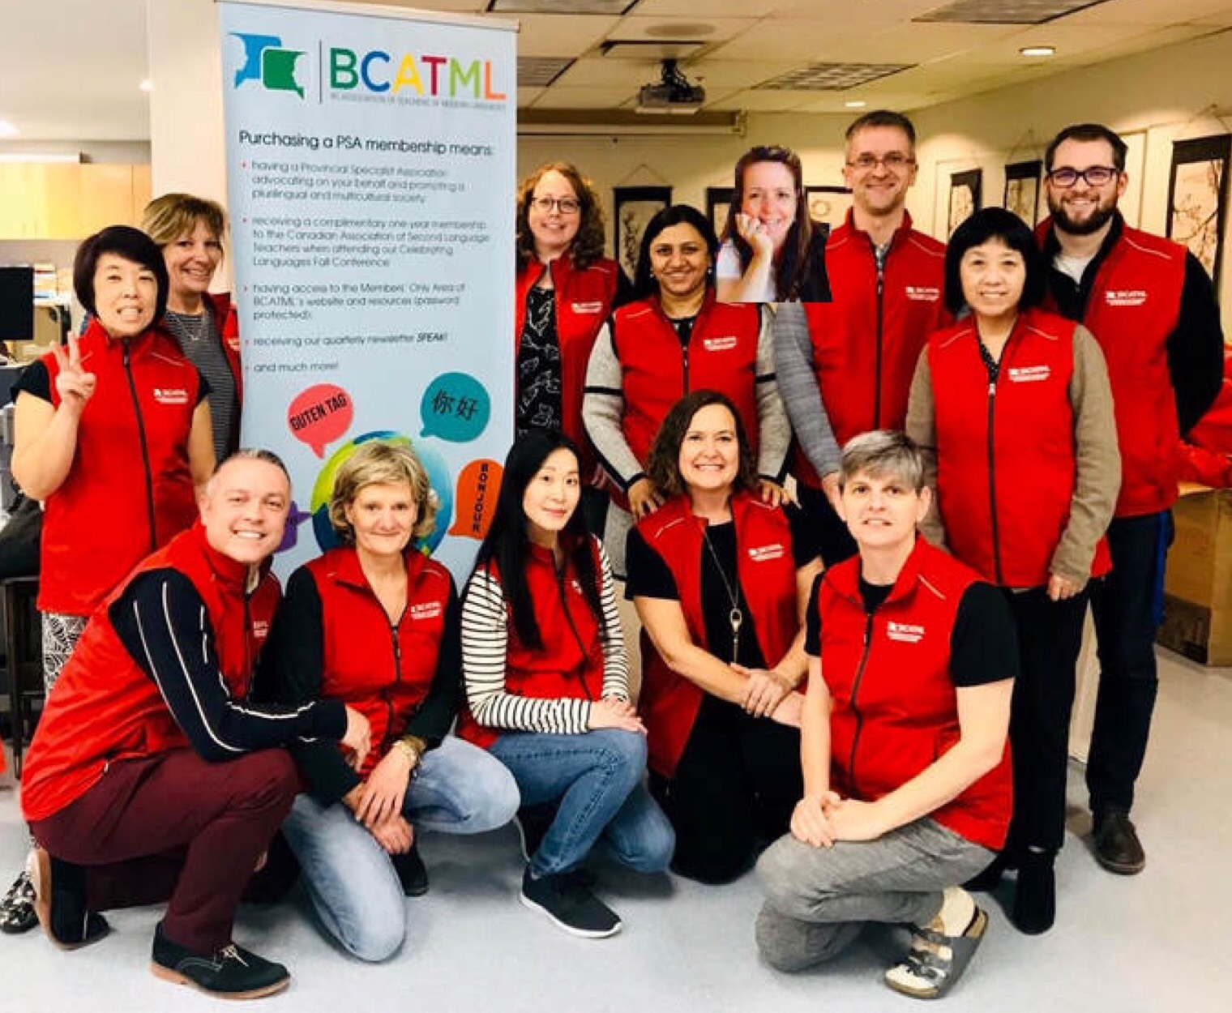
4. Recognition of BCATML Executive members:
Antonella Bullen | Secretary / Membership
Tanya Campbell | Elementary/Middle Yrs Rep.
Amandeep Chhina | Punjabi Representative
Shireen Cotterall | Spanish Representative
Kindra Harte | Vice-president
Grace Ho | Japanese Representative
Angela Kleine-Buning | German Representative
Trish Kolber | French Representative
Rome Lavrencic | President
Ping Li | Mandarin Representative
Andrew McFayden | Other Languages Rep.
Dylan Trerice | Web Manager
Wendy Yamazaki | Treasurer
Notes:
Here are the dedicated VOLUNTEERS of your BCATML Executive. These educational leaders are advocates for second languages and strive to improve language programs for all BC students and teachers. Please join me in giving them a well-deserved round of applause using your reactions tab along the bottom of your screens or shout outs in the chat window.

Slide 7
4. Recognition of BCATML Conference members:
Notes:
Here are the volunteers of this year’s Conference Committee who sacrificed evenings, weekends, and holidays to provide a top-notch professional development conference. Please join me in giving them a round of applause for all their hard work and effort to ensure an engaging day of professional growth and learning. There is another level of planning required when organizing a completely virtual online conference.

Slide 8
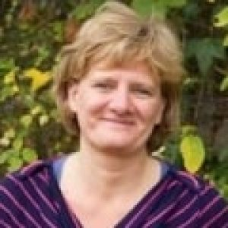
4. Retirees of BCATML Executive :
Shireen Cotterall
Served two years
Spanish Representative
Conference Programme
Centro Mundo Lengua Scholarship
Independent School representative
Grace Ho
Served four years
Japanese Representative
Conference Presenters Coordinator
Conference Programme
BCATML Welcome Brochure
BCATML Calendar
Metro Vancouver Japan Bowl
UBC Japanese Speech Contest Judge
Dylan Trerice
Served two and a half years
Web Manager
Conference Co-Chair
Streamlined website & social media
CPF BC & Yukon Treasurer
Angela Kleine-Büning
Served twelve years
German Representative
Liaised with Goethe-Institute, German Language Advisor (Western Canada)
Saxony Teacher exchanges w/ BCATML
Organized L2 exams up to C1 proficiency!
President BC Council of German Teachers
Amandeep Chhina
Served five years
Punjabi Representative
Conference Presenters & Entertainment
Advocate for Punjabi studies in SD36
Punjabi speech writing and poetry contests
Notes:
These are this year’s retirees. It is quite difficult to see these incredible leaders leave our Executive. Our Executive Board has nothing but love, respect, and admiration for each of these individuals and we thank them for their incredible years of service and dedication. We wish them well and all the success in the next steps in their professional journey.

Slide 9
5. BCATML Constitutional amendment:
Motion #3: That the BCATML Constitution, article 5 – Committees, paragraph 1 be amended and read as follows:
The executive committee shall consist of the Past-president and the following members in good standing, all of whom are to be elected annually at the Annual General Meeting of the BCATML, for a term of one year. An individual may only hold a specific position on the Executive, through re-election, for a maximum of five years. The executive committee shall not exceed 14 members.
Rationale: By adding a term limit to each Executive position, it is hoped that this will encourage new people to become part of the Executive and bring new ideas and perhaps a different perspective. It will also encourage senior Executive members to learn other positions within the Association.
a. Table Officers: | b. Other members:
Past-president President Vice-president Secretary / Membership Treasurer | Elementary / Middle Years Representative French Representative German Representative Japanese Representative Mandarin Representative Punjabi Representative Spanish Representative Other Languages Representative Web Manager

Slide 10
6. President’s report: A year in review …

Slide 11
BCATML Memberships for the last decade:
2014 & 2015: Joint spring conference with myPITA 2019: Saanich Conference
2017: BCTF Super Conference (optional PSA fees) 2020: BCATML & CASLT joint conference
Notes:
Historical representation of BCATML memberships over the last decade. Note that the 2017 BCTF Super Conference did not mandate PSA memberships as part of the conference fees.
Several Executive members have undertaken training at the BCTF as Newsletter Editor, Treasurer, Conference Chair, and Workshop facilitators.

Slide 12
Advocacy & partnerships:
Educational Programmes and Workload Working Group – Ministry of Education
Response to the draft K-12 Reporting Order (deadline: Nov 5th, 2021) – Min. of Education
https://engage.gov.bc.ca/govtogetherbc/consultation/studentreporting/
Languages Template updated document – Ministry of Education https://curriculum.gov.bc.ca/curriculum/languages-template
BCTF: PSA Council, ASC-PSAC, Advisory Committee on French programs & services
Canadian Association of Second Language Teachers (bi-lateral agreement & representation)
BC Language Coordinators’ Association;
The Canadian Teaching Chinese as a Second Language Association;
Goethe-Institute; The Japan Foundation (Toronto)
Centro Mundolengua (Saville, Spain)

Slide 13
BCATML outreach and support:
BCATML workshops available for member request
https://www.bcatml.org/bcatml-workshops.html
SD#57 (Prince George – annual Spring Fling) and SD#73 (Kamloops-Thompson)
Elementary Core French, Secondary French and Spanish workshops offered
UBC, SFU, and UVic Pre-service teachers invited to attend fall conference
Development of pedagogical resources for COVID-19 and language acquisition
https://www.bctf.ca/classroom-resources (TeachBC database)
UBC Okanagan: invited to develop French/Spanish resource teaching non-binary

Slide 14
BCATML Outreach:
Joint spring conference with myPITA
Sessions on Core French and International Languages
45 new members to BCATML

Slide 15
BCATML Scholarships & Grants:
BCATML Student Scholarships:
www.bcatml.org (Funding tab)
Four $500 post-secondary scholarships awarded this year
2021 recipients:
Jessica Bullen, Daniel Damien, Annika Rempel, and Rebecca Sy.
Deadline to apply is May 1st, 2022.
BCATML Teacher Grants:
www.bcatml.org (Funding tab)
Four $500 grants to improve language & proficiency skills at post-secondary or continuing education classes
2020 recipients:
Linda Cavalière, Reiko Domai, and Doris Durupt
Deadline to apply is Dec. 31st, 2021.
Notes:
- BCATML offers four $500 scholarships and grants to graduating students to pursue their language studies at the post-secondary level, as well as support teachers wishing to improve or learn a new language to teach.

Slide 16
Advocacy: MOE bursaries for educators expanded
Bursaries available for any teacher wishing to attend training programs in French language and/or French teaching methods offered in Canada or conference hosted by ACELF, ACPI, APPIPC, BCATML, BCLCA, or CASLT.
Bursaries are on a first-come, first-served basis.
Apply early (months in advance)
https://www2.gov.bc.ca/assets/gov/education/ways-to-learn/french-programs/french_bursary_criteria.pdf
Or visit www.bcatml.org (Funding tab)
Notes:
- Best kept secret is the additional funding for BC teachers to attend a conference or training program to improve one’s understanding of French. Apply *EARLY* (months in advance) to see if you have been awarded funds.

Slide 17
Post-secondary Language Programs:
www.bcatml.org (Resources tab)
Consolidation of all BC post-secondary institutions offering second language studies
URL link to institutions;
Satellite campuses listed;
Languages offered;
Student testimonials; and
Contact addresses for more info.
Notes:
BCATML consolidated all known post-secondary institutions in BC and the languages they offer to undergraduate students.

Slide 18
BCATML Beautiful British Columbia Photo Contest:
www.bcatml.org (Resources tab)
Showcase your part of BC on the cover of the next issue of our newsletter!
Win $50 gift certificate of your choice
Deadlines:
Nov. 1st, March 1st, August 1st
Notes:
- Beautiful British Columbia contest is a creative and fun way to get more involved with your Provincial Specialist Association and to educate other teachers in the province about the beauty found throughout BC. The entry form takes less than 5 minutes to complete and helps you to learn the different indigenous lands upon which we live, we learn, we play, and we do our work.

Slide 19
Truth and Reconciliation initiatives:
Joint project with FNESC to endorse translations of First People Principles of Learning posters.
3 x $1,000 donations to:
Indian Residential School Survivors Society
The Lytton First Nations – Tl’kemtsin
BC Wildfire Relief Canadian Red Cross
Notes:
BCATML made donations to provide mental health services for Indigenous communities reliving the trauma of the recent discovery of children’s bodies on former residential school grounds and to help rebuild Indigenous communities in our province, with a special targeted donation to the First Nations community of Lytton.

Slide 20
BCATML looking ahead:
FNESC to endorse translated FPPOL posters
French/Spanish non-binary terminology resource
2022 Cultural Calendar for greetings
BCATML virtual book club (2 books!!)
Meet the new Executive & Language Reps session
Meet BCATML-CASLT representatives
After school webinar series for assessment
Monthly after school sessions to support elementary Core French with Tanya Campbell
Conference 2022: Oct. 21 in Richmond
Notes:
- A list of some of the projects we are working on this year; realizing that the COVID-19 pandemic may limit our ability to host some of these events.

Slide 21
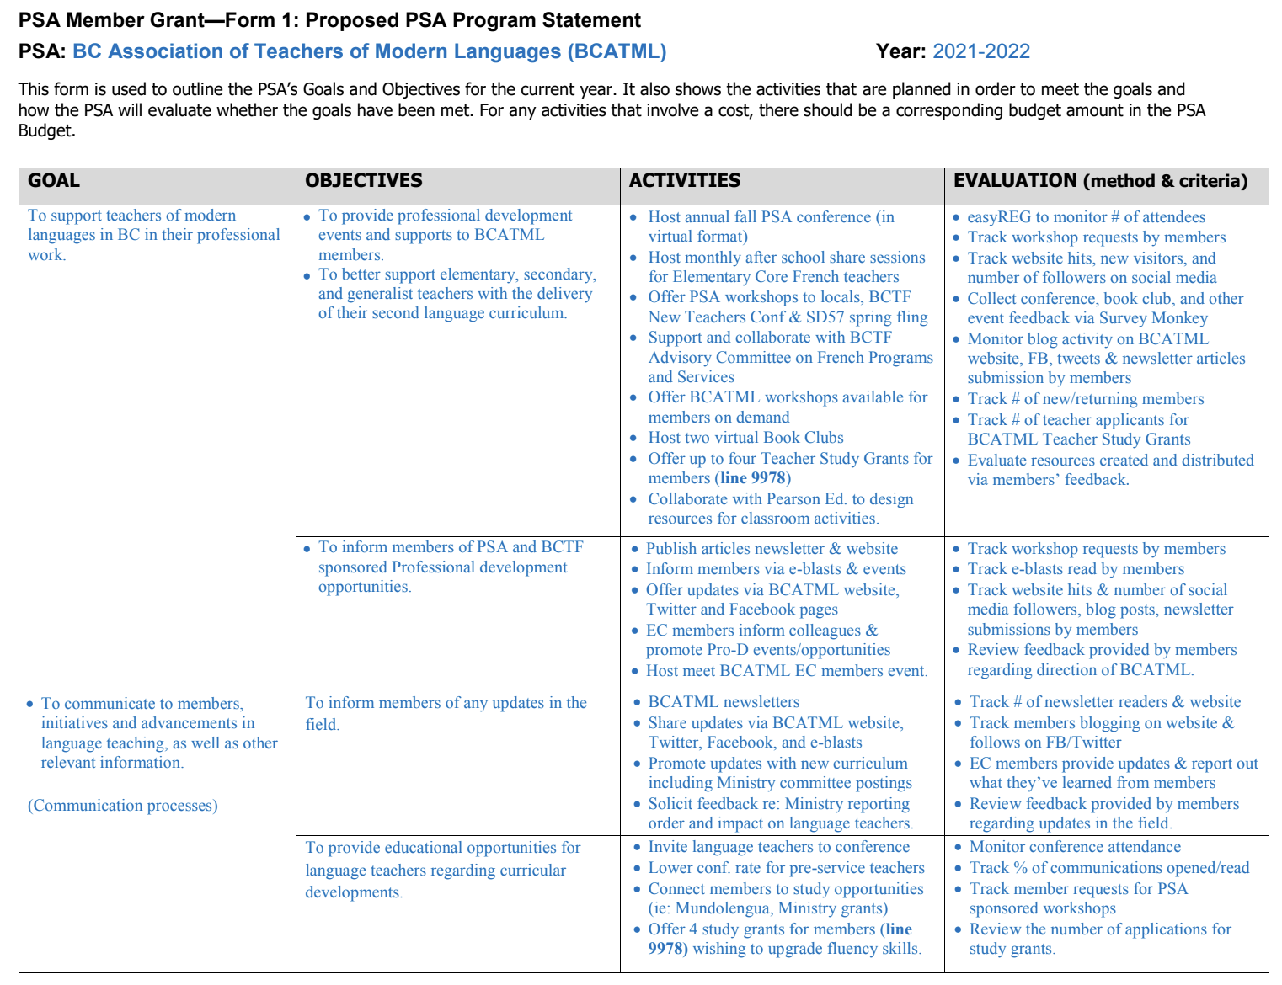
BCATML Program Statement:
QR Code to BCATML Program
Statement for 2021-2022
Notes:
BCATML Program Statement for 2021-2022. URL Link: https://drive.google.com/file/d/1B3XPtnjeZ8chinR3qO1SRyBl-95ZrKOL/view?usp=sharing

Slide 22
Motion #4: To adopt the president’s report and BCATML Program Statement for 2021-2022.
Notes:
Motion #4: To adopt the president’s report and BCATML Program Statement for 2021-2022.

Slide 23
7. Treasurer’s report:

Slide 24
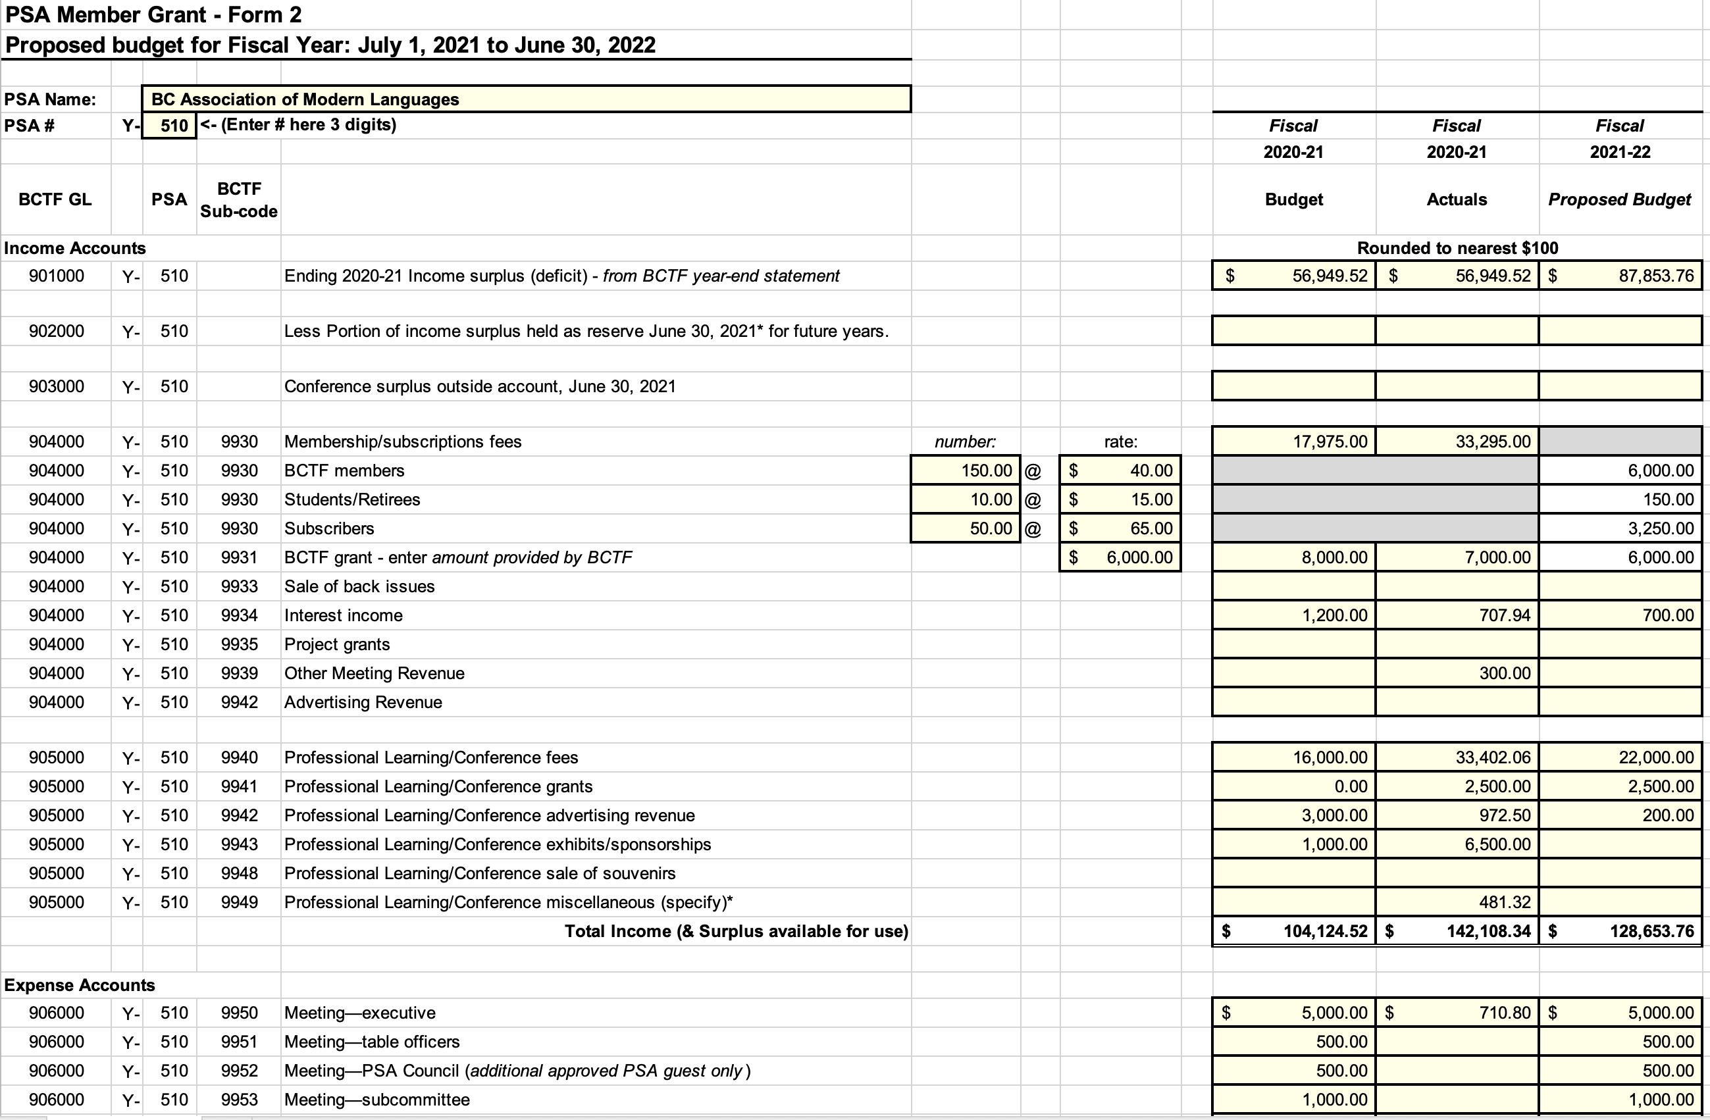
BCATML Proposed Operating Budget 2021-2022:
QR Code to BCATML Proposed
Budget for 2021-2022
Notes:
BCATML proposed Operating Budget for 2021-2022. URL Link: https://drive.google.com/file/d/1D_FypfXVAiuJQf8VLHnLQ9T6C7syE7Rc/view?usp=sharing

Slide 25
Motion #5: To adopt the proposed operating budget for 2021-2022.
Notes:
Motion #5: To adopt the proposed operating budget for 2021-2022.

Slide 26
8. Election of BCATML Executive Committee 2021-2022:

Slide 27
Only active BCTF members of BCATML may run for office and vote
President: | Rome Lavrencic
Vice-President: | Kindra Harte
Treasurer: | Wendy Yamazaki
Secretary & Membership: | Antonella Bullen
Elementary & Middle Years Rep: | Tanya Campbell
French Language Rep: | Trish Kolber
German Language Rep: | Lidija Bakovic
Japanese Language Rep: | ___________________________
Mandarin Language Rep: | Ping Li
Other Languages Rep: | Susana Stover
Punjabi Language Rep: | Manjeet Brar
Spanish Language Rep: | Andrew McFayden
Web Manager: | Meaghan Bowes
Notes:
- Only active BCTF members in good standing are eligible to run for office and to vote. There will be three calls for nominations for any Executive position from the floor. For any contested position, each candidate will be given one minute to address the AGM before votes are cast using the Poll feature in Zoom. All other positions will be acclaimed.

Slide 28
Motion #6: To adjourn the Annual General Meeting of the BCATML.
Notes:
Motion #6: To adjourn the Annual General Meeting of the BCATML.

Slide 29
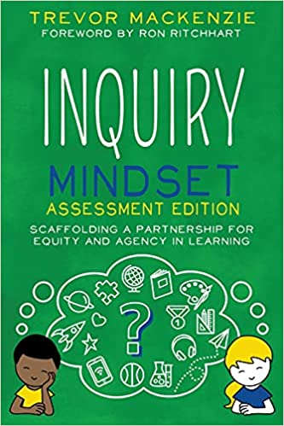
Door prizes:
There are 10 $50 gift certificates for any the following:
Amazon.ca, Chapters Indigo, Michaels, and Starbucks
BCATML has generously donated 5 copies of the following two books for members to join our virtual book club:
Inquiry Mindset Assessment Edition by Trevor Mackenzie
Connecting with Students Online by Jennifer Serravallo

